Slide 1



2027 State of New Mexico HSA
Understanding Your Long-Term Health Savings Tool
Presented by
EASI GOV

Slide 2
What is a Health Savings Account (HSA)?
Plan | Minimum | Maximum
Self-Only | NONE | $4,400
Family Coverage | NONE | $8,750
An HSA is a tax-advantaged savings account for individuals enrolled in a qualified High-Deductible Health Plan (HDHP) (Silver PPO)
Accounts is YOURS
Pays for medical expenses now and later
Medical Savings Accounts
Balance Rolls over, no use it or lse it
Catch-Up Contribution
Age 55 and up | $1,000

Slide 3
HSA VS FSA
Plan | Rollover | Portability | Investment | Time Limit
FSA | NONE | NO | NO | Plan Year
HSA | All | YES | YES | Anytime
The State of New Mexico Offers FSA AND HSA plans
FSA Health Plans are funded up-front
You fund Your HSA Plan
You can enroll in an FSA plan with ANY state plan
Can only enroll in HSA with High-Deductible Health Plan (Silver PPO)

Slide 4
Advantages
Tax Savings
Self-Directed
Contributions are tax-deductible
Earnings and interest in account grow tax free
Distributions used for qualified medical expenses are not taxed
Contribute extra amounts to grow you account
Keep track of your own expenses

Slide 5
Eligibility Requirements
To contribute to an HSA, you must meet the following criteria:
Enrolled in a qualified High-Deductible Health Plan (HDHP) (Silver PPO)
Not covered by any other non-HDHP health plan (such as a spouse’s coverage).
Not enrolled in Medicare or Medicaid
Not claimed as a dependent on someone else's tax return.

Slide 6
Medical Expenses, Eligible and Otherwise
IRS Publication 502
Eligible Expenses:
Dual-Purpose Items:
Doctor visits
Surgeries
Dental/vision care
Prescriptions
Medical Equipment (Crutches, monitors, and so on)
Over the counter medication (What’s in your medicine cabinet)
Menstrual care products
Dual-Purpose Items
Items like Vitamins, supplements, or gym memberships require a Letter of Medical Necessity (LMN) from your Dr.

Slide 7
Keeping Track of Your Expenses
It is YOUR responsibility to keep track of your expenses!
Best practices:
Receipt with your name,
Provider name
Date of service
Type
Cost
  Record Keeping
  Keep all your receipts
  Use the receipt organizer, snap and save!
  Keep three years of records

Slide 8
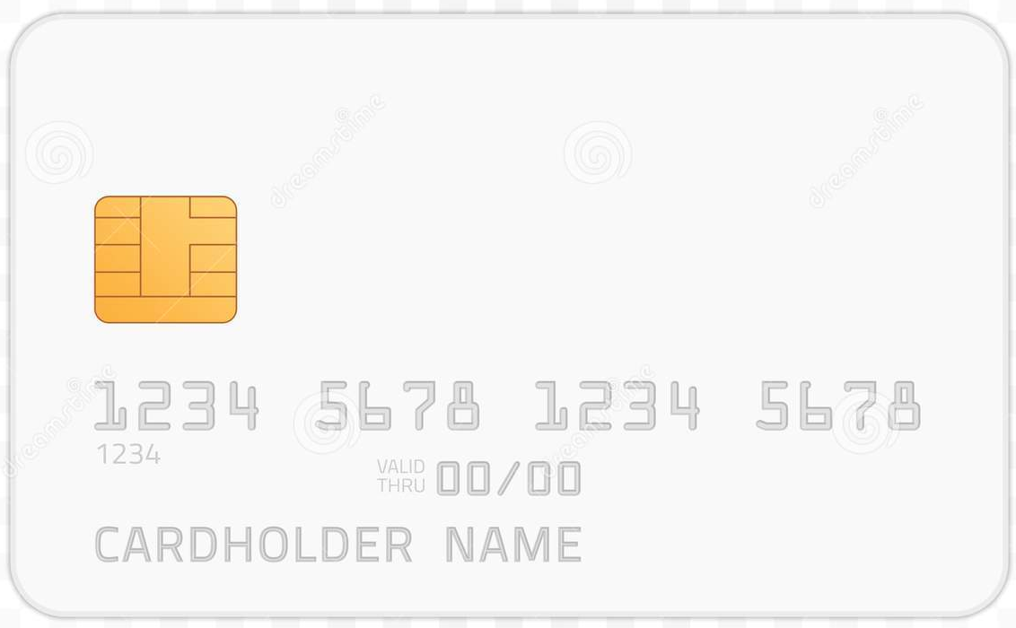

The HSA Debit Card
Provided for HSA Accounts
Two cards initially
Works for you and your covered dependents
Additional cards cost $10.00
Allows you to pay for qualified expenses directly from your HSA at time of service
  May still require additional documentation after purchase
  Keep detailed receipts and EOBs for all debit card purchase for claims submission

Slide 9
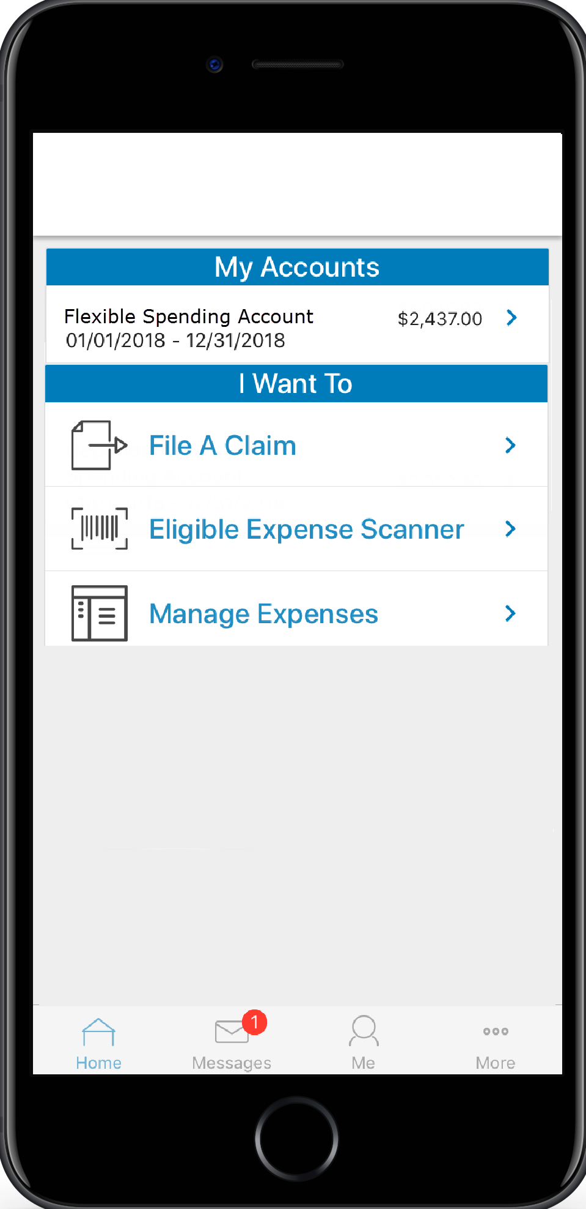
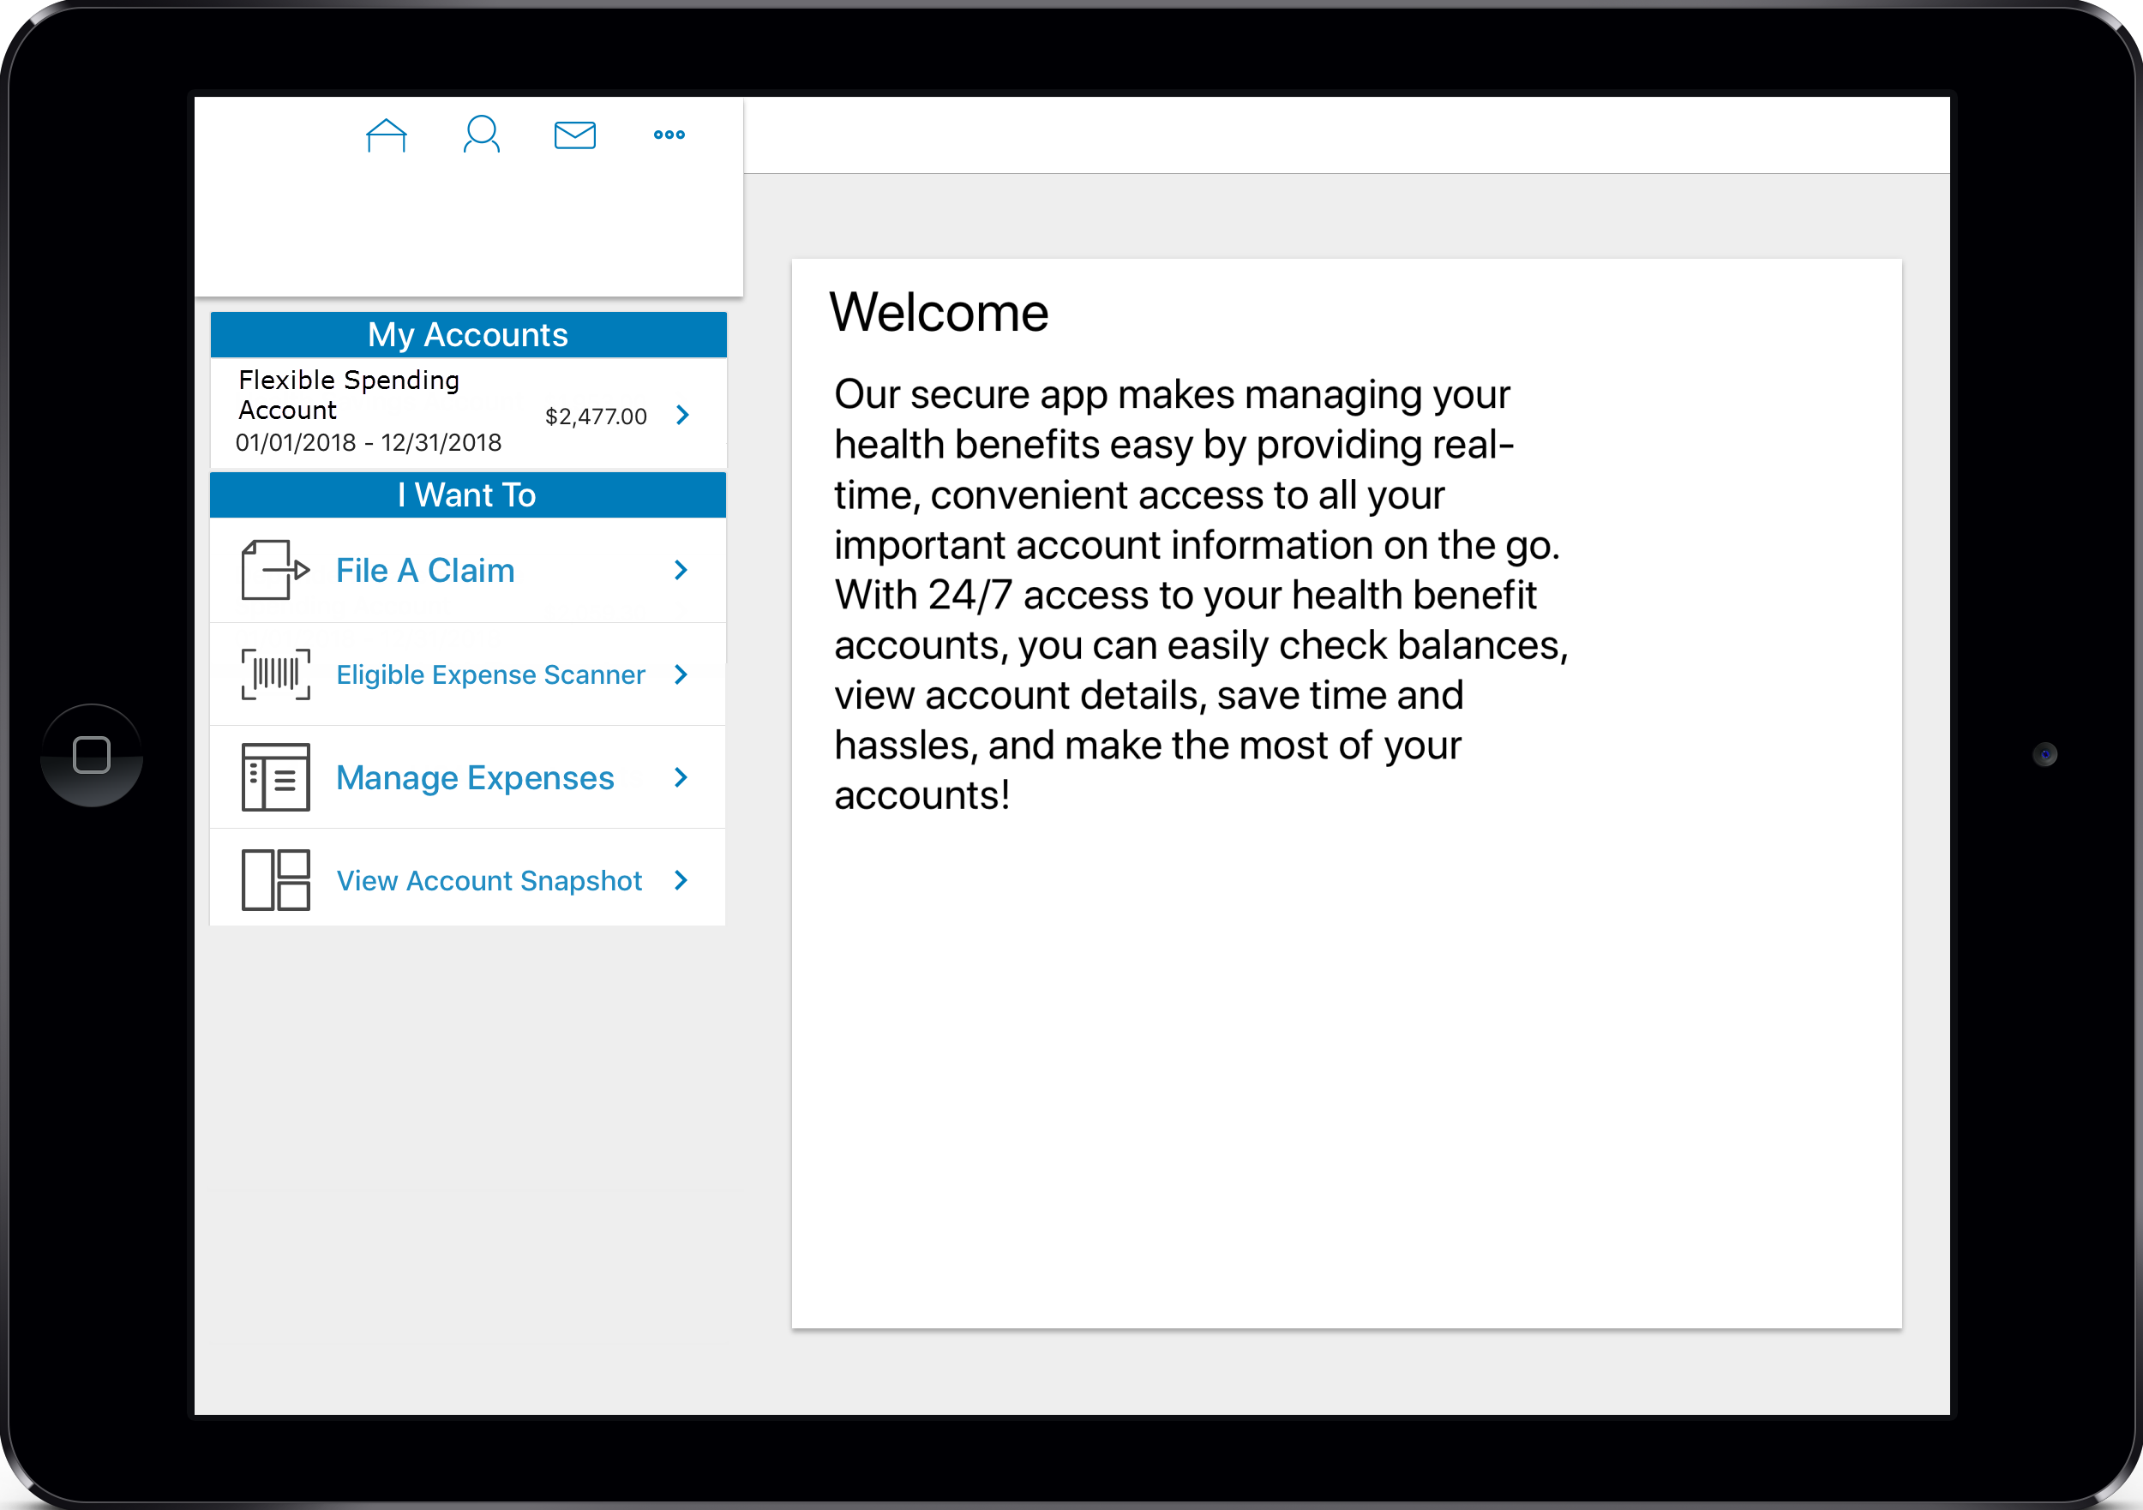
Where to Manage your HSA
Access your account online using your desktop or our mobile app
  You can visit Erisa Trust directly for the PC version of the app at https://www.erisa-trust.com/sonm and choose “Portal Login”
  To find the mobile app, search “BenefitsbyET” in the Android Store or Apple App store
Submit claims and upload receipts using the mobile app, or from your desktop
You can view your account and update your own contact information
Add your bank account to setup direct deposit of reimbursements and repayments
Manage your investment options
Visit https://www.mybenefitsnm.com/benefitsInformation.html# for more information
EASIGOV.COM
HSASTORE.COM

Slide 10
How to Enroll in HSA for 2026
Plan | Minimum | Maximum
Self-Only | NONE | $2,200
Family Coverage | NONE | $4,375
Enroll at MYBENEFITSNM.COM
ELECT High-Deductible Plan (SILVER PPO)
Select ‘Enroll in HSA/Dependent Care
Pick your Election for 07/01/2026-12/31/2026
Re-Enroll During Q4 2026
Catch-Up Contribution
Age 55 and up | $500

Slide 11
Thank You!
For questions or assistance call 1-855-618-1800 or email HSA@easitpa.com

