Slide 1

MetLife Dental Plan Information
Full Plan Year
July 1, 2026 – June 30, 2027
A partnership to smile about.
Powerful network. Extraordinary experiences
Notes:
Welcome, and thanks for joining. Today we’ll walk through your MetLife Dental benefits for the next full plan year July 1, 2026 through June 30, 2027. We’ll cover what’s included, how to save money, and the tools available to help you get the most out of your dental coverage.

Slide 2




Deductibles
$50.00 per enrolled person during the plan year
$150.00 total per family
Deductible does not apply to Diagnostic & Preventive Services or Orthodontic Services
Benefit Annual Maximum
$1,750 per enrolled person, per plan year on the Base plan
$2,000 per enrolled person, per year on the Buy Up plan
Orthodontic Lifetime Maximum
Children – up to 18th birthday
Base Plan Pays 75%, up to a $2,000 lifetime maximum
Buy Up Plan Pays 75%, up to a $2,500 lifetime maximum
Adults – age 18 and over
Base Plan Pays 60%, up to a $1,750 lifetime maximum
Buy Up Plan Pays 60%, up to a $1,750 lifetime maximum
Dental
Highlights
Notes:
We can see here the highlights and key features of your dental plan, including deductibles, annual maximums, and orthodontia coverage for both children and adults. Preventive care like cleanings and exams are covered without having to meet the deductible, and you’ll see higher annual maximums if you choose the new Buy‑Up plan offered.

Slide 3
MetLife Dental Benefits – Buy Up Option Now Available
IN-NETWORK
OUT-OF-NETWORK
Preventive Services – No Deductible
Covered: Oral Exam & Cleanings (2 per plan year) X-rays Topical Fluoride Emergency Treatment Sealants & Space Maintainers |  | MetLife Pays: 100% of discounted Network Fee for both Base and Buy Up plans | You Pay: 0% for both Base and Buy Up plans | MetLife pays: 100% of the Reasonable and Customary fee You pay any amount over allowable fee for both Base and Buy Up plans
Basic Services – Deductible Applies
Covered: Fillings Extractions Root Canals | Periodontics General Anesthesia | MetLife Pays: 80% of discounted Network Fee for Base plan & 90% for Buy Up plans | You Pay: 20% for Base plan & 10% for Buy Up plan | MetLife pays: 55% of the Reasonable and Customary fee; You pay 45% plus any amount over allowable fee for both Base and Buy Up plans
Major Services – Deductible Applies
Covered: Crowns Implants Bridges and Dentures |  | MetLife Pays: 60% of discounted Network Fee for both Base and Buy Up plans | You Pay: 40% for both Base and Buy Up plans | MetLife pays: 35% of the Reasonable and Customary fee; You pay 65% plus any amount over allowable fee for both Base and Buy Up plans
Notes:
Here’s how preventative, basic, and major services are covered under both the Base and Buy Up plans. Preventive care is covered at 100% when you visit a network dentist so be sure to schedule your two preventive visits each plan year to maximize your benefits. For basic and major services, the Buy‑Up plan pays an even higher percentage at network dentists, which can lower your out‑of‑pocket costs if you expect dental work beyond routine care.

Slide 4

You can save money by going to a MetLife network provider through deep discounts on dentist fees as well as through higher plan coverage!
*Example: Employee needs a filling
How can our PPO Network
Lower your out-of-pocket costs?
Employee A has the
Base Plan & goes to a Network Provider
Employee B has the
Buy Up Plan & goes to a Network Provider
Employee B goes to an
Out-of-Network Provider
Plan Coverage
Type B – plan covers 80%
Provider has agreed to MetLife’s reimbursement / fee.
Discounts vary by zipcode
Type B – plan covers 90%
Provider has agreed to MetLife’s reimbursement / fee.
Discounts vary by zipcode
Type B – plan covers 55%
Provider is allowed Co charge their prevailing fee
No Discounts
Costs
Network Fee: $211
Plan coverage: $168.80
Employee Out-of-Pocket: $42.20
Network Fee: $211
Plan coverage: $189.90
Employee Out-of-Pocket: $21.10
Dentist Average Charge $345
Plan coverage: $189.75
Employee Out-of-Pocket: $155.25
*Example is for illustration purposes. Charges vary based on plan and dentist.
Notes:
Both the Base and Buy Up plans use the MetLife PDP Plus Network. Shortly, we will also share more about Spotlite dentists which is a highlighted group within the network. One of the easiest ways to save money is by using a MetLife network dentist. Network providers agree to discounted rates with MetLife, and your plan pays more of the cost. This example shows how choosing a network provider, especially when also participating in the Buy Up plan, can significantly reduce what you pay.

Slide 5

Orthodontia Coverage
Ortho coverage available for all ages!
Child Orthodontia
Adult Orthodontia
Available for Ortho treatment starting prior to a covered child’s 18th birthday
MetLife pays 75% up to $2,000 for Base plan and up to $2,500 for Buy Up plan
Coverage maximum is a lifetime max
Available for any treatment for covered adults, aged 18+
MetLife pays 60% up to $1,750 for both Base and Buy Up plans
Coverage maximum is a lifetime max
Notes:
Orthodontia coverage is available for both children and adults. Children must begin treatment before age 18, and coverage is paid up to a lifetime maximum depending on the plan you choose. Adult orthodontia is also covered, which is not something all dental plans offer.

Slide 6

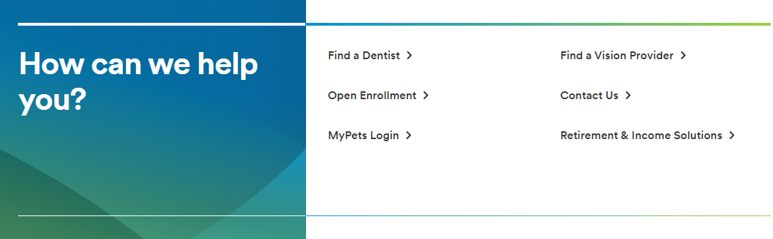



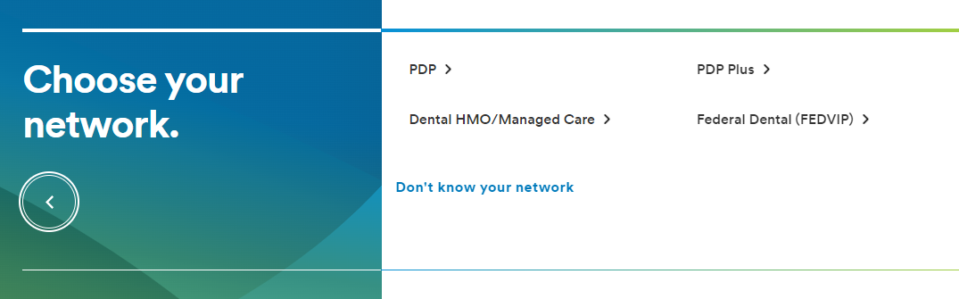
How do I find a Network Provider?
With MetLife Dental insurance, you can choose from thousands of general dentists and specialists nationwide. You can find the names, addresses, languages spoken and phone numbers of participating dentists by searching our online Find a Dentist directory.
Step 1:
Go to metlife.com
Step 2:
Select “Find a Dentist” next to “How can we help you?”
Step 3:
Select “PDP Plus” next to “Choose your network.”
Enter your Zip, City or State and select the “Find a Dentist” button.
52 unique NM providers added in the last 6 months!
Notes:
You can easily find a network dentist using MetLife’s Find a Dentist tool. Just visit metlife.com, select ‘Find a Dentist,’ choose the PDP Plus network, and search by ZIP code or city to find participating providers near you. We are also excited to share that 52 new unique providers were added to the network within New Mexico in the last 6 months!

Slide 7


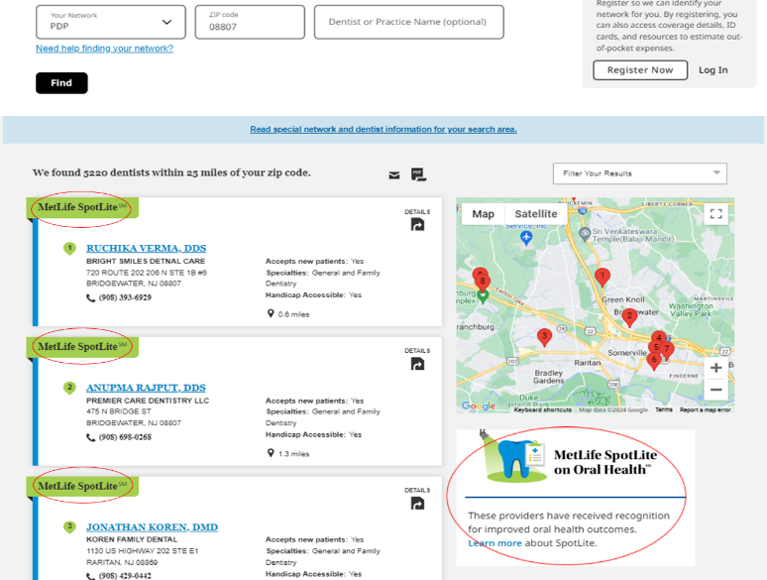
Directory that helps identify improved health outcome focused providers
Employees can locate SpotLite providers in their area through our Find a Dentist online tool
City | All Providers within 25 miles | SpotLite Providers within 25 miles
Albuquerque, NM (ZIP 87111) | 1,593 | 349
Rio Rancho, NM (ZIP 87124) | 1,169 | 343
Alamogordo, NM (ZIP 88310) | 28 | 4
Hobbs, NM (ZIP 88240) | 13 | 1
Portales, NM (ZIP 88130) | 49 | 7
Notes:
When you search for a network dentist, you will see some providers highlighted as SpotLite dentists. These are dentists within the MetLife network who focus on preventive care and improved oral health outcomes. You can find SpotLite providers using the same Find a Dentist tool we reviewed in the slide previously. Use this tool today to help you make informed choices about your care.

Slide 8
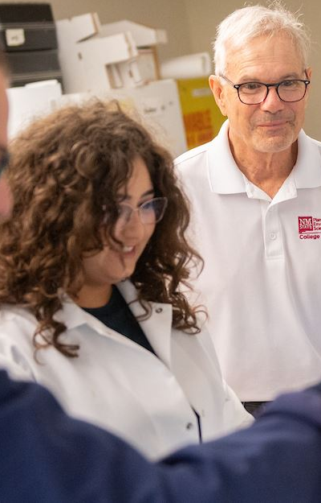
Getting a
pre-treatment estimate is fast and easy!
MetLife suggests you request a pre-treatment estimate before having certain complex dental services performed, such as crowns, bridges, dentures or periodontal work (typically those that will cost over $300), so that you can appropriately budget for the service or discuss what potential alternative treatment options may be available, if necessary.
Requesting a pre-treatment estimate is like submitting a claim before the dental procedure or service has taken place. The process is simple, and it gives you important information about what services are covered and at what level benefits may be payable.
Your dentist can find out what your plan may pay and what your out-of-pocket expense may be while you are still in the office.
Notes:
For more complex or costly dental work, MetLife recommends requesting a pre‑treatment estimate. This lets you see what your plan may cover and what your out‑of‑pocket cost could be before you move forward with treatment.

Slide 9

Teledentristy
As part of your plan, you have access to a virtual dental network available 24/7 in the palm of your hand. MetLife has partnered with Virtual Dental Care to provide a nationwide network of virtual dentists who can see you when you are in pain or unable to visit a dentist.
You can connect with a licensed dentist using Dental.com to help address urgent dental situations or to discuss your Smart Scan results. Some examples of dental needs that can be addressed include:
How to access:
Gather your dental history and jot down any questions or concerns for your provider before your visit.
Log in to your MyBenefits Account at online.metlife.com. On both the Accounts page and the Find a Dentist page, you will find the “Start Virtual Visit” link.
Register or log in to your Virtual Dental Care account.
Begin your call in a quiet, well-lit room.
Why use Teledentistry?
Visual consult or exam.
Prescriptions for antibiotics or pain.
Oral hygiene instruction.
Evaluation to prioritize care.
Referrals to in-network providers.
Information you’ll need to get started:
Your employee ID or SSN
Date of birth
Email and password for registration and login
Notes:
MetLife Dental also offers a Teledentistry option. With teledentistry, you can connect with a licensed dentist anytime, anywhere. This option is best for urgent dental concerns, pain, or questions when you can’t get to a dentist right away. It’s a best practice to have all of the information ready before you register or log in to your Virtual Dental Care account.

Slide 10
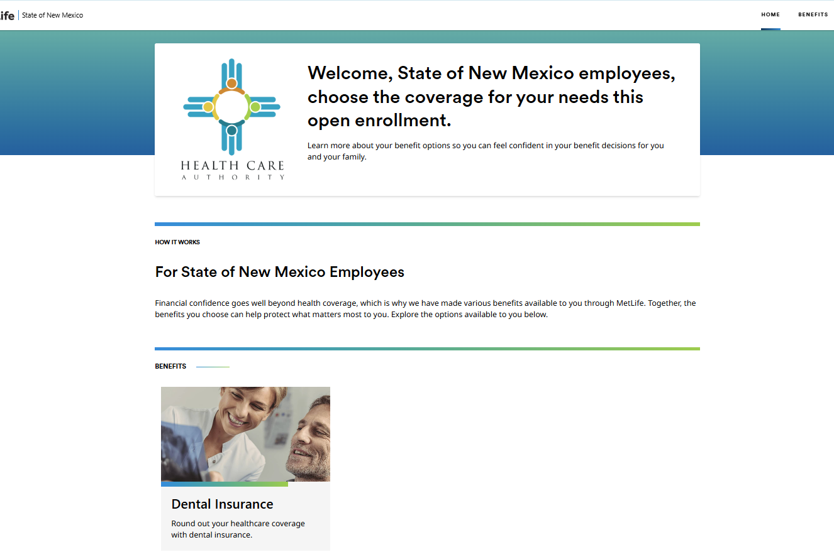
MyBenefits – Find Care, Understand Costs, Manage Your Plan
The MyBenefits website is a quick and easy way to get the information you need about your MetLife benefits—all in one place. Log in at metlife.com/mybenefits to see how we’ve taken personalization and integration to a new level.
Get more information on your MetLife benefits, where you can link to detailed coverage information and can perform tasks, such as:
Dental Plans – Easily find a participating dentist or view your plan benefits including detailed coverage explanations
Dental ID cards - available online to download and print at your convenience.
Claim Info - track your claims and sign up for email notifications called eAlerts
Forms and documents – download needed forms and access our extensive Oral Health Library to research important dental topics.
Notes:
MyBenefits is your employee portal making it easy to manage your dental plan online. If you have not already registered, you will need to select “State of New Mexico” and register with your information to access your coverage. Once logged in, you can find dentists, check coverage, estimate the cost of service, track claims, and access your dental ID card—all in one place.

Slide 11

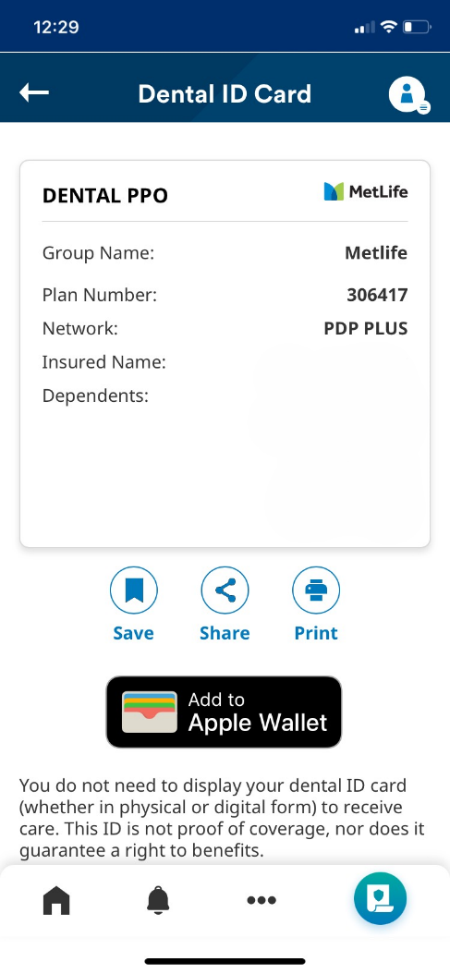
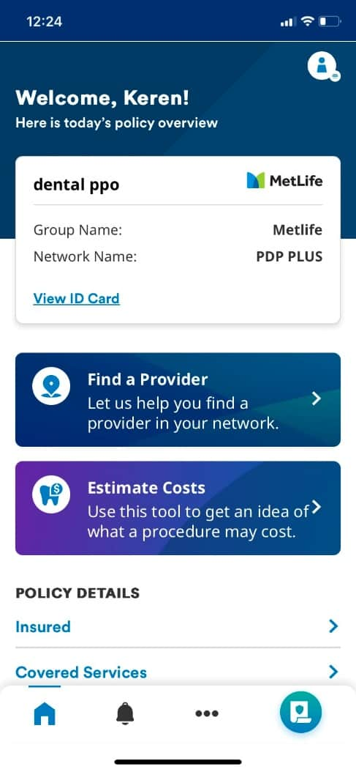
Helping you and your families manage your benefits
With MyBenefits and the MetLife Mobile App, you can…
Leslie Young
Leslie
View plan design details and enrollment status for all products
Estimate dental
procedure costs
Colin Young
Leslie Young
Colin Young
Find a dentist and
SpotLite provider
Access health library and educational tools
University of California
Check recent claims
and status
Virtual assistant
available 24/7
View and print Dental ID cards; or add
to Apple Wallet
File a dental claim online
Notes:
Managing your benefits is easy with MyBenefits access and by downloading the MetLife Mobile App. Also important to note, you don’t need a physical dental ID card to receive dental care. Dentists can verify your benefits electronically, making visits simpler and faster.

Slide 12

Why MetLife Dental?
Save money by staying in‑network – Choose from a large MetLife dental network, including SpotLite dentists focused on preventive care and better long‑term oral health.
Know your costs before you go – Use online tools and pre‑treatment estimates to understand what your plan pays and what you may owe.
Easy access to care and support – Manage your plan, find dentists, estimate costs, and use virtual dental visits through MyBenefits and the MetLife Mobile App.
Notes:
Before we wrap up, here are some key takeaways. First, you can save money by using in‑network dentists—MetLife gives you access to a large network designed to keep your costs lower. Second, you don’t have to guess what something will cost. You can check coverage and estimate costs ahead of time using simple online tools provided to you. And finally, getting care and support is easy. With MyBenefits, the mobile app, and virtual dental visits, help is available when and where you need it.

Slide 13


Thank
You!
Register with MyBenefits today! www.metlife.com/mybenefits
Call:
1-866‑506‑5231
Mondays - Fridays, 6 a.m. – 7 p.m., MT Saturdays - Sundays, 8 a.m. – 5 p.m., MT
Customer Service Information Preferred Dentist Program
1-800-942-0854
Notes:
If you have questions, MetLife’s customer service team is available to help. Don’t forget to also register for MyBenefits to access your information anytime.

Slide 14

Thank You!
Innovating to bring the best network to
all of New Mexico
Notes:
Thank you again for taking the time to learn about your dental benefits. We’re excited to support you and your family’s oral health throughout this new plan year.

